Slide 1
Pretty Programming and Packaging with Python
Fedor Baart, Genna Donchyts, Hessel Winsemius
Slides and course material will be made available on a network location

Slide 2

As we all know – python is…
A scientific data language
  Similar power as, or even more than Matlab
  Free!
  Open-source, developed by the python community
  so….

Slide 3
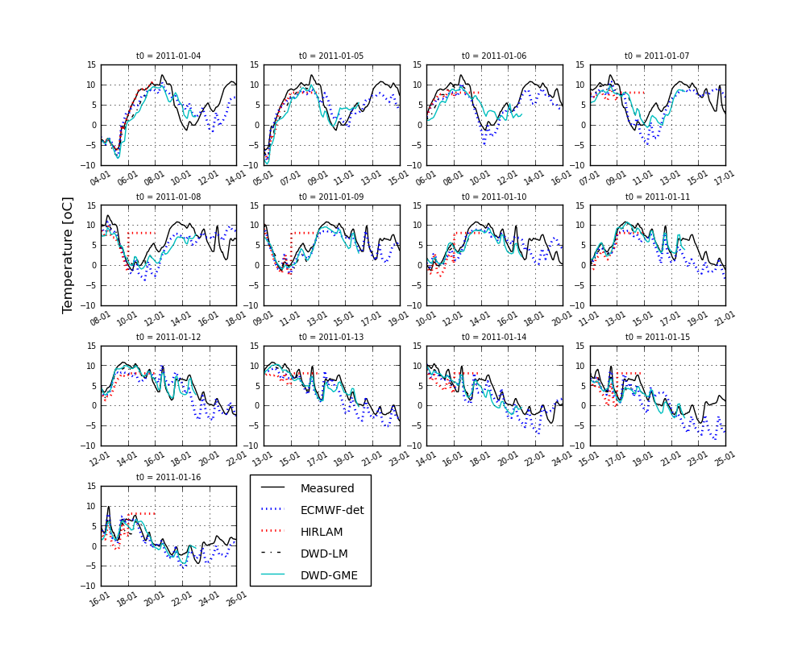
Applications at Deltares
Flood risks with IMAGE scenarios: using python to link PBL – Deltares models
KvK theme 6: implementing experimental models in python-PCRaster extention
OpenEarth utils
Analysis of Rhine flood Jan.
2011: powerful plotting utilities

Slide 4
This course
Check your pizza!!!
1: Python installers for HDW Windows 7
2: Licensing and version management, how to obey Deltares quality plan
3: Some fun! IPython Notebooks – Interactive drafting of code
4: Code guidelines
PIZZA!!!
5: Python paradigm: style guides
6: Packaging - how to put something online (pypi) for other python users?
16:00 – 16:15
16:15 – 16:30
16:30 – 17:00
17:00 – 17:30
17:30 – 18:00
18:00 – 19:00
19:00 – 19:30
19:30 – 20:00

Slide 5

Python installers for HDW
Python x,y (https://code.google.com/p/pythonxy/)
The good news:
  In app-store
  Has an awesome amount of pre-installed stuff!
    netCDF4-python (inc. libraries)
    Geospatial Data Abstraction Library (sometimes a pain to install)
    Spyder (nice interface)
The bad
  In app-store (yes, that’s also a ‘bad’)
  32-bit only (Uggghhh!!!)!!!
  Cannot install outside app-store
  Only Windows
  Max Python 2.7

Slide 6

Python installers for HDW
Anaconda
A big snake in the South-American rain forests

Slide 7
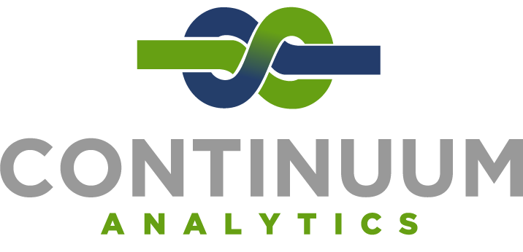
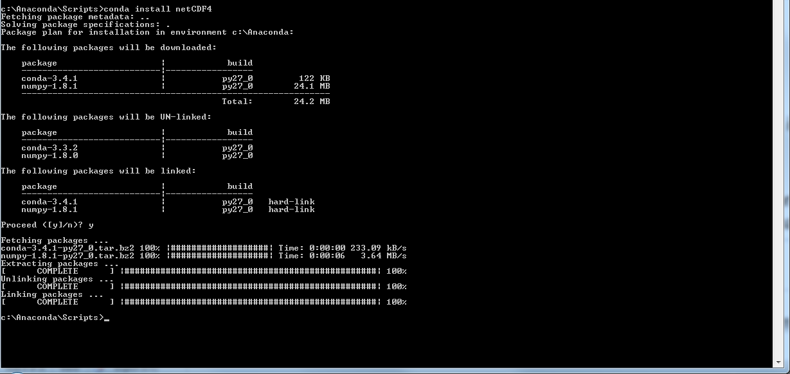
Python installers for HDW
Anaconda (http://continuum.io/downloads)
The bad
  Some pain-in-the-butt packages are not included
    GDAL
    netCDF4-python
    But…
The good
  Installer ‘conda’ solves
  build-dependencies and includes
  correct libraries
  In app store (Only after ICT request, Grmpf)
  But can also be installed without app store (! Don’t use the app store, it may prevent you from installing additional packages)
  64-bit (AWESOME!!!)
  Python 2.x, 3.x

Slide 8
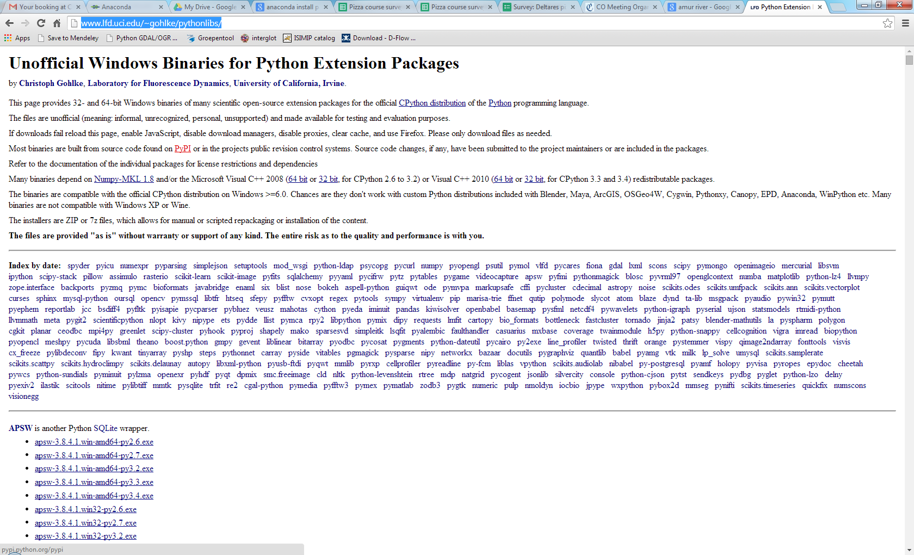
Python installers for HDW
Anything missing in your HDW laptop?
http://www.lfd.uci.edu/~gohlke/pythonlibs/

Slide 9
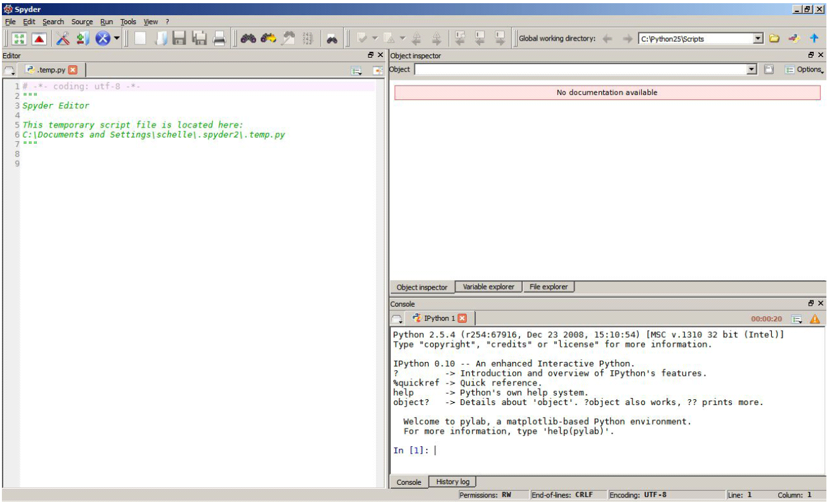
Python installers for HDW - Spyder
Well-equipped Matlab-like console (Spyder) with powerful editing and debugging functions
on-the-fly documentation on functions that you use
Edit your scripts with colored syntax and syntax error notifications
console

Slide 10
List of alternative editors
eMacs
pyCharm
Spyder
Sublime
Python tools for Visual Studio (for VS users, includes nice debugging)

Slide 11
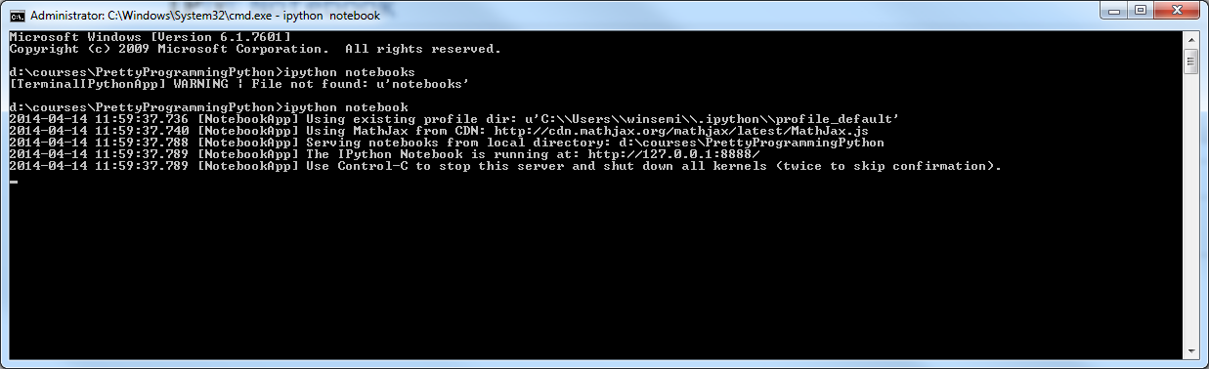
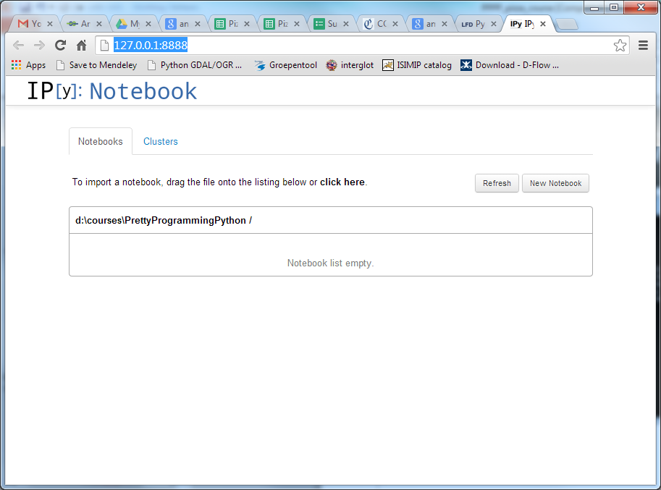
Even more interactive: IPython notebooks

Slide 12
IPython notebooks
IPython: Interactive Python
Web-based GUI
Interactive scripting and plotting (since IPython 2.0)
Combine scripting, text and comments
Try as you go way of working
Also ideal for courses
More info op http://ipython.org/notebook.html

Slide 13
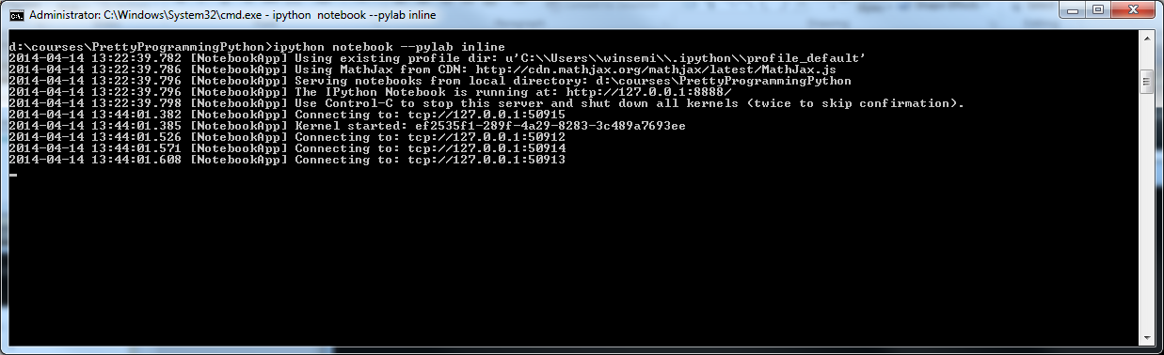
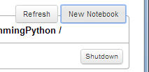
How to set up a notebook
Add ‘--pylab inline’ to have inline plotting enabled

Slide 14
Setup
Work with ‘cells’ consisting of …
Code (which will actually run on the web-based GUI in IPython)
Markdown
Raw text (looks uglier than markdown)
Headings
Running:
Per cell (moves automatically to next cell)
All at once
Saving:
Save with checkpoint (revert to checkpoint if you like)
Save as .py (for further use, packaging and so on)

Slide 15
Some examples
Simple plot example (sin/cos)
Include a function (head draw down from a well)
Plot hurricanes in a geographical map
Interact with your plot
Try it with your own dataset/script!

